Slide 1

Lesson 03 Code Generation and Deployment to OpenPLC
Dr. David J. Coe
Electrical and Computer Engineering Department
University of Alabama in Huntsville
coed@uah.edu

Slide 2
Outline
Code Generation
Code Deployment
Suggested Reading
Hands-On Laboratory Exercise #3

Slide 3
Code Generation

Slide 4
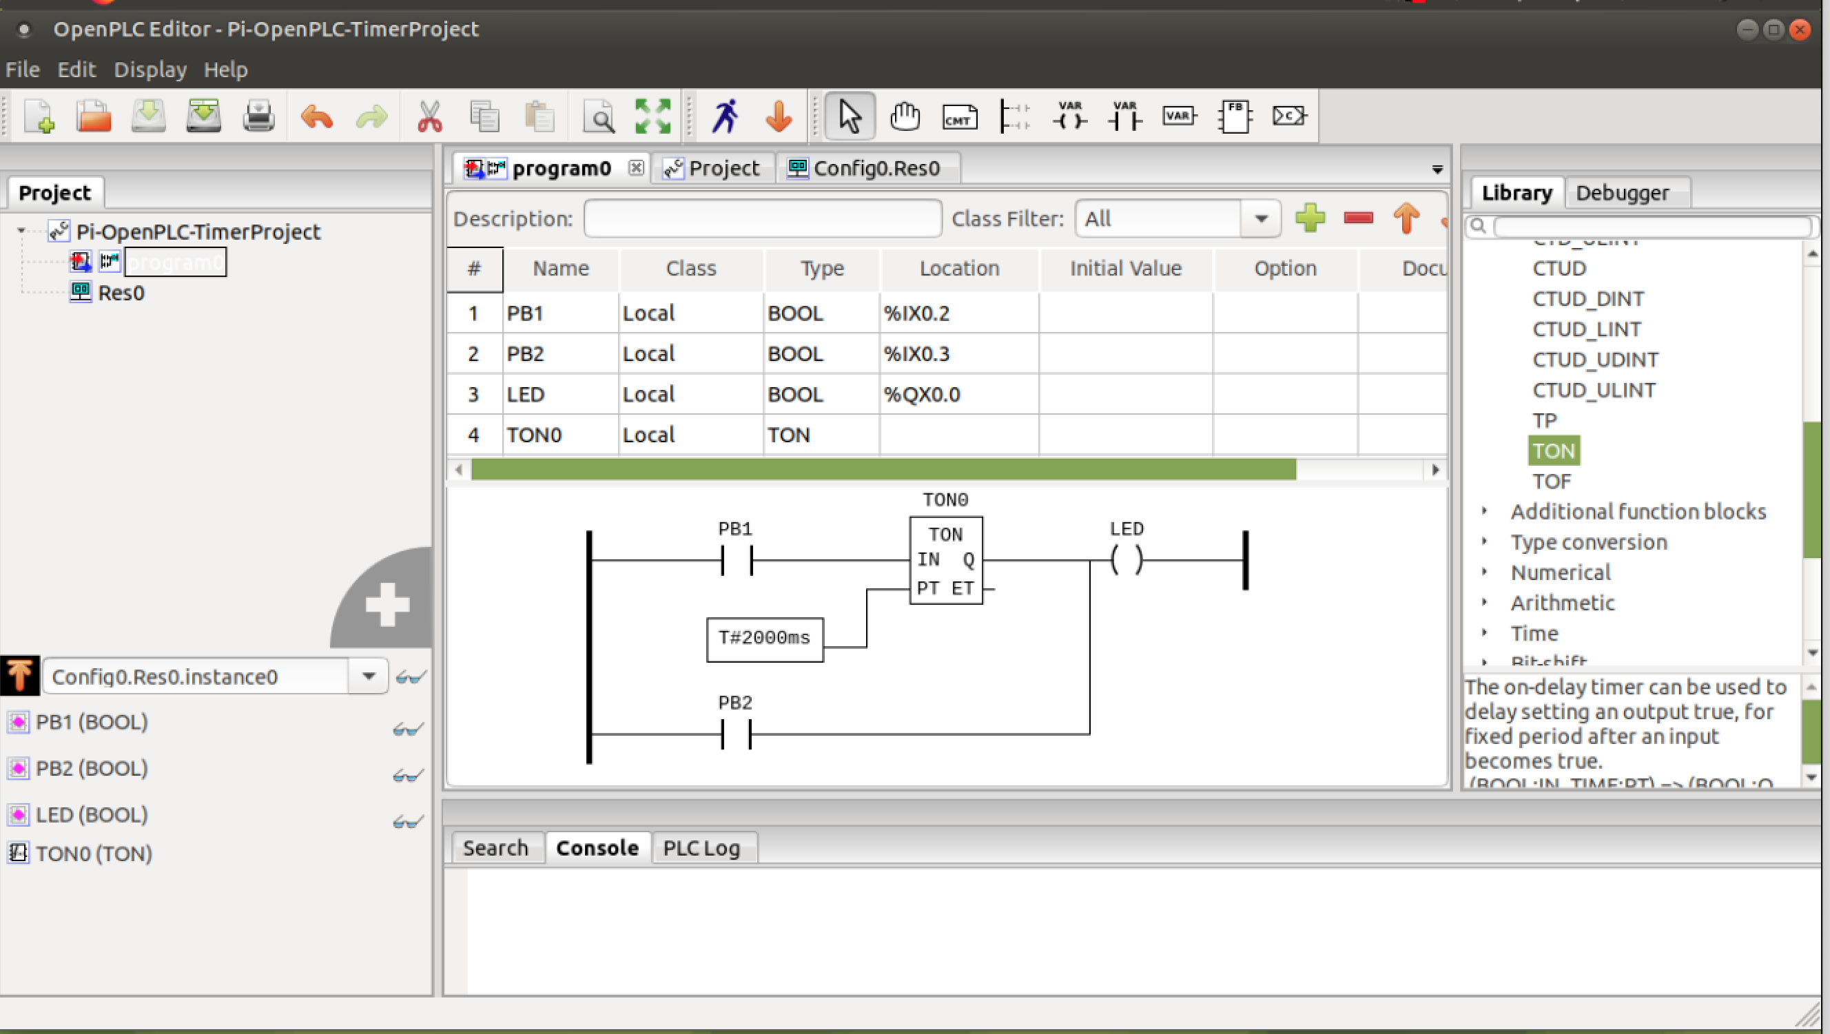
Generate Structured Text - 1
Locate code generation menu button on toolbar

Slide 5
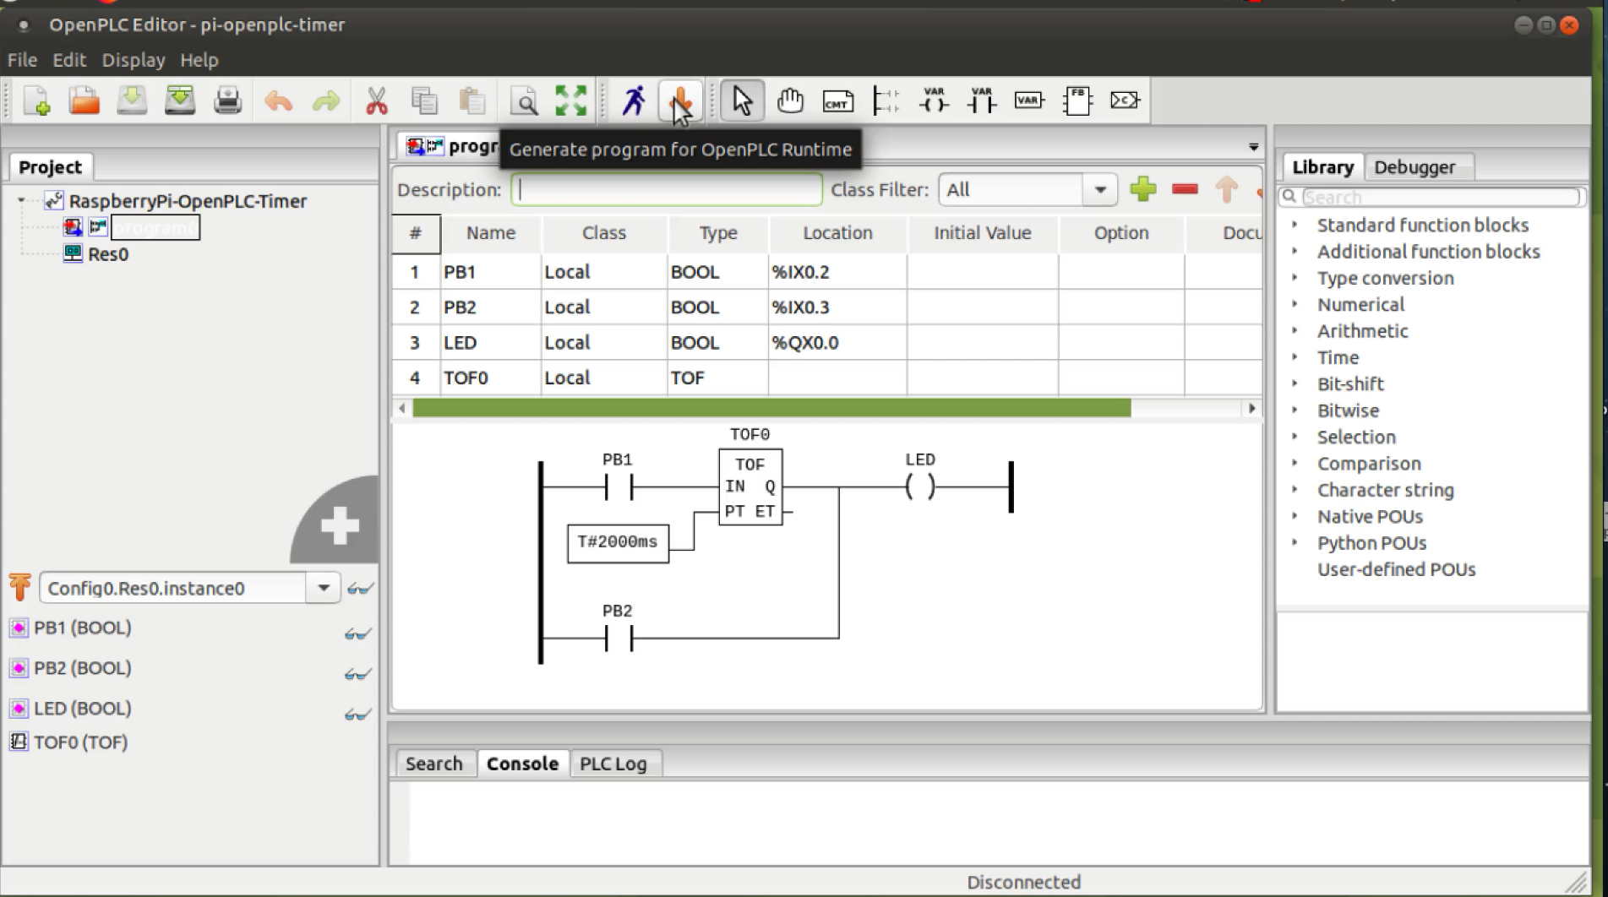
Generate Structured Text - 2
Click on code generation menu button

Slide 6
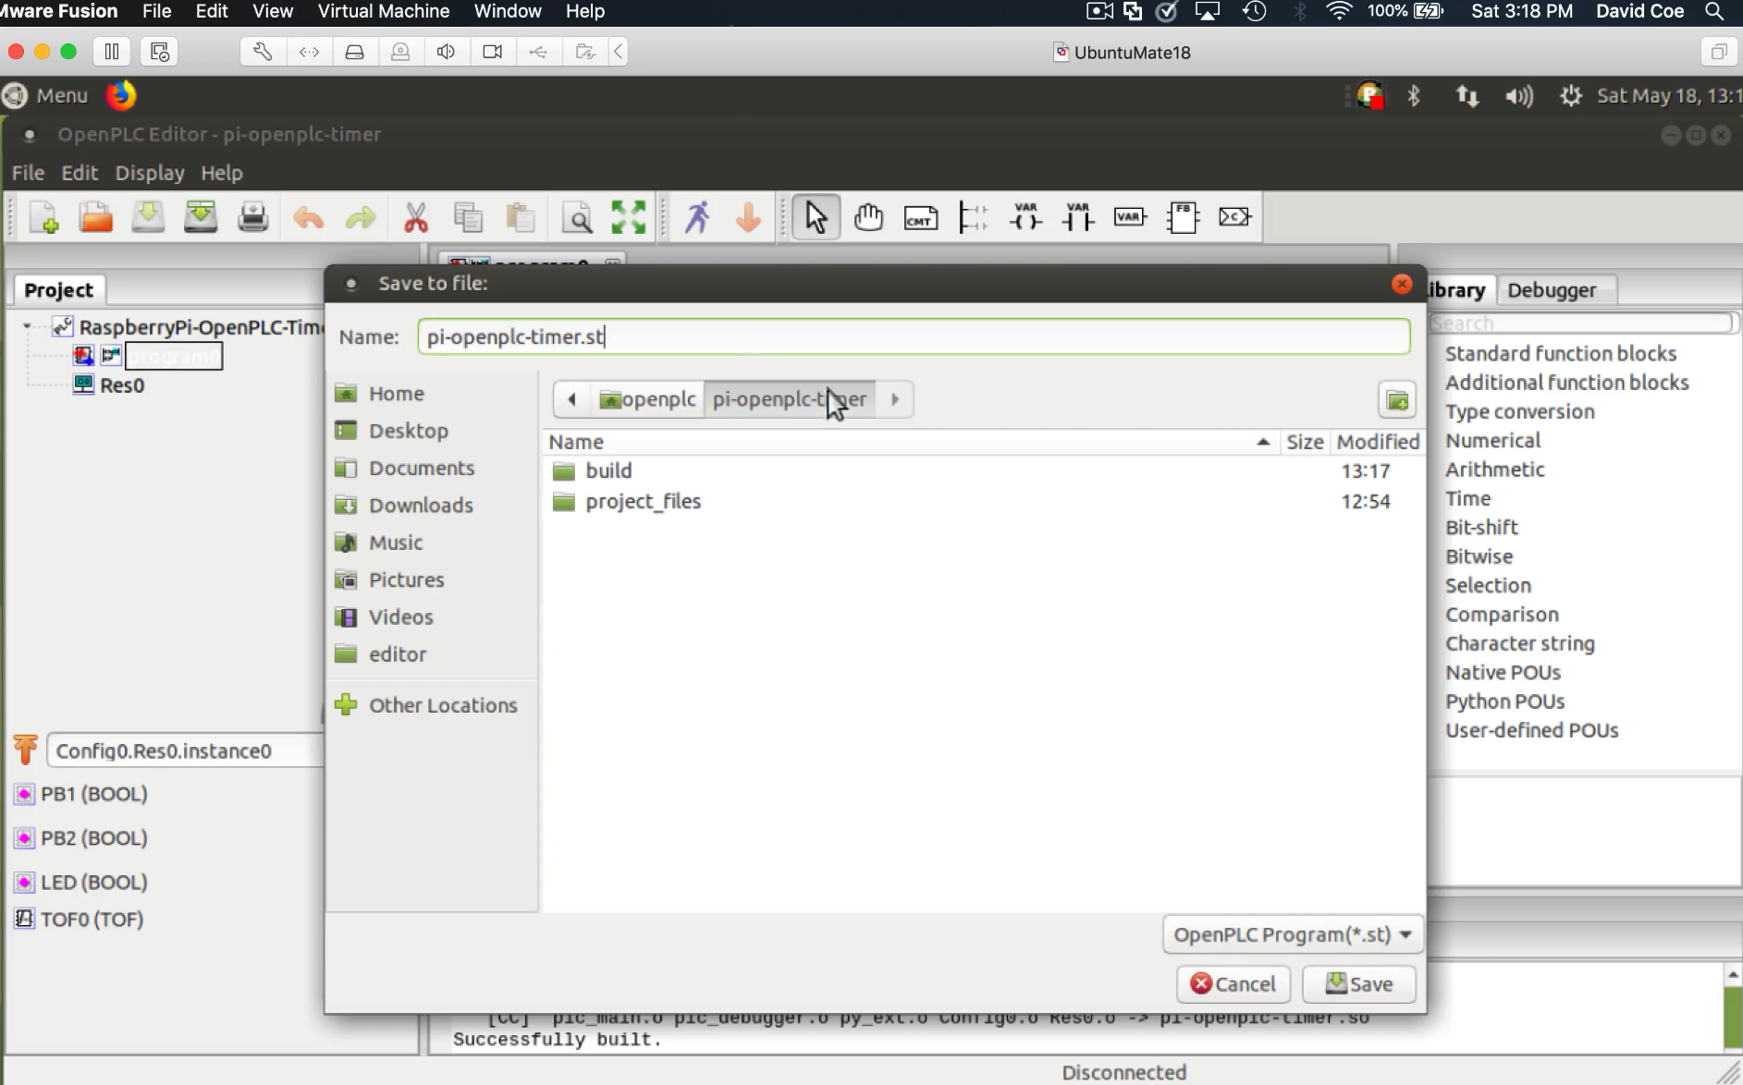
Generate Structured Text - 3
Select location to save code and enter filename

Slide 7
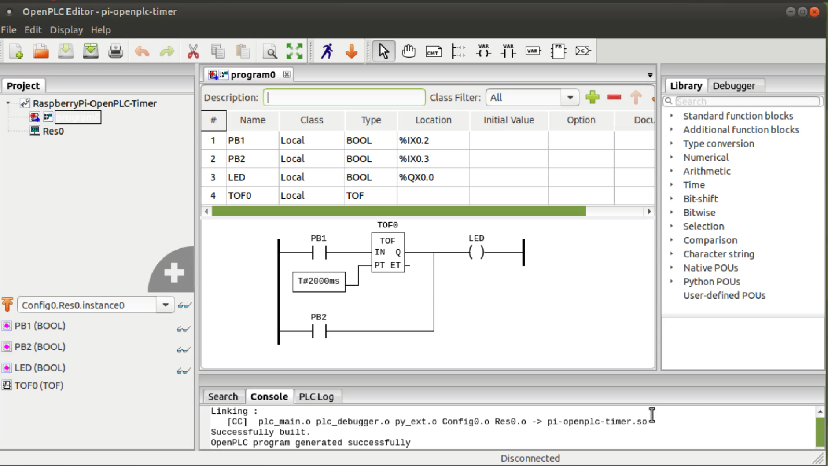
Generate Structured Text - 4
Ladder Logic translated successfully into Structured Text

Slide 8
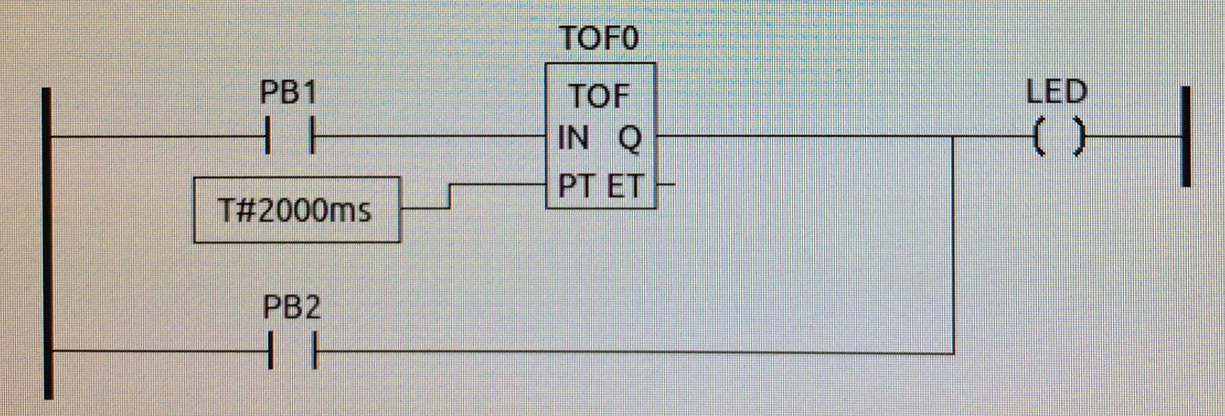
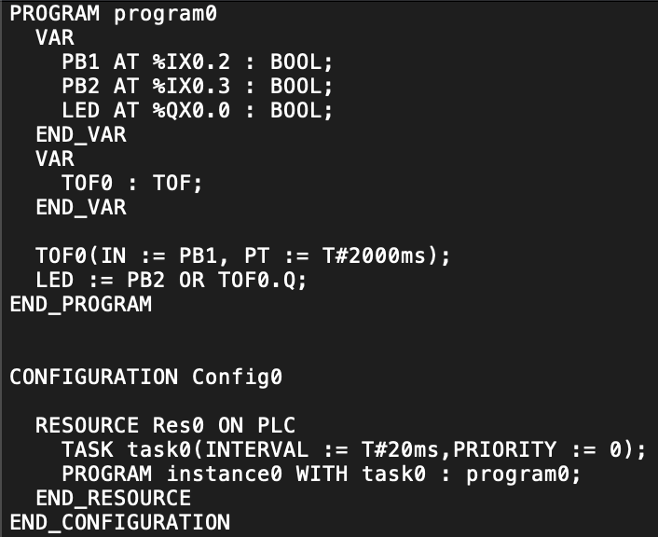
Ladder Logic versus Structured Text

Slide 9
Code Deployment

Slide 10
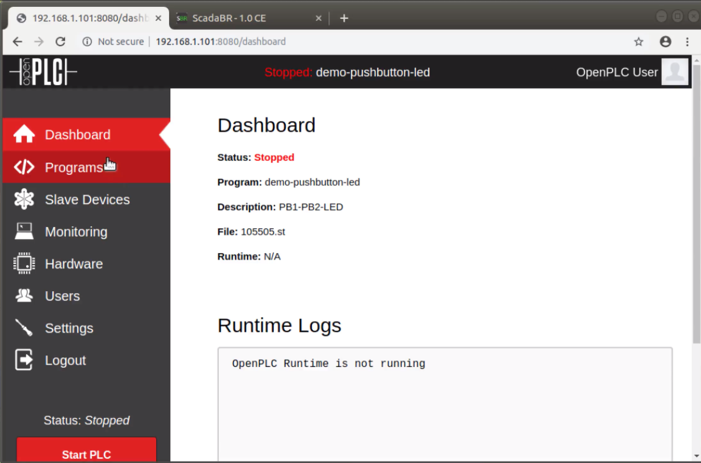
Code Deployment to OpenPLC - 1
Use browser to access OpenPLC server on physical hardware
A different program is currently loaded and ready to execute

Slide 11
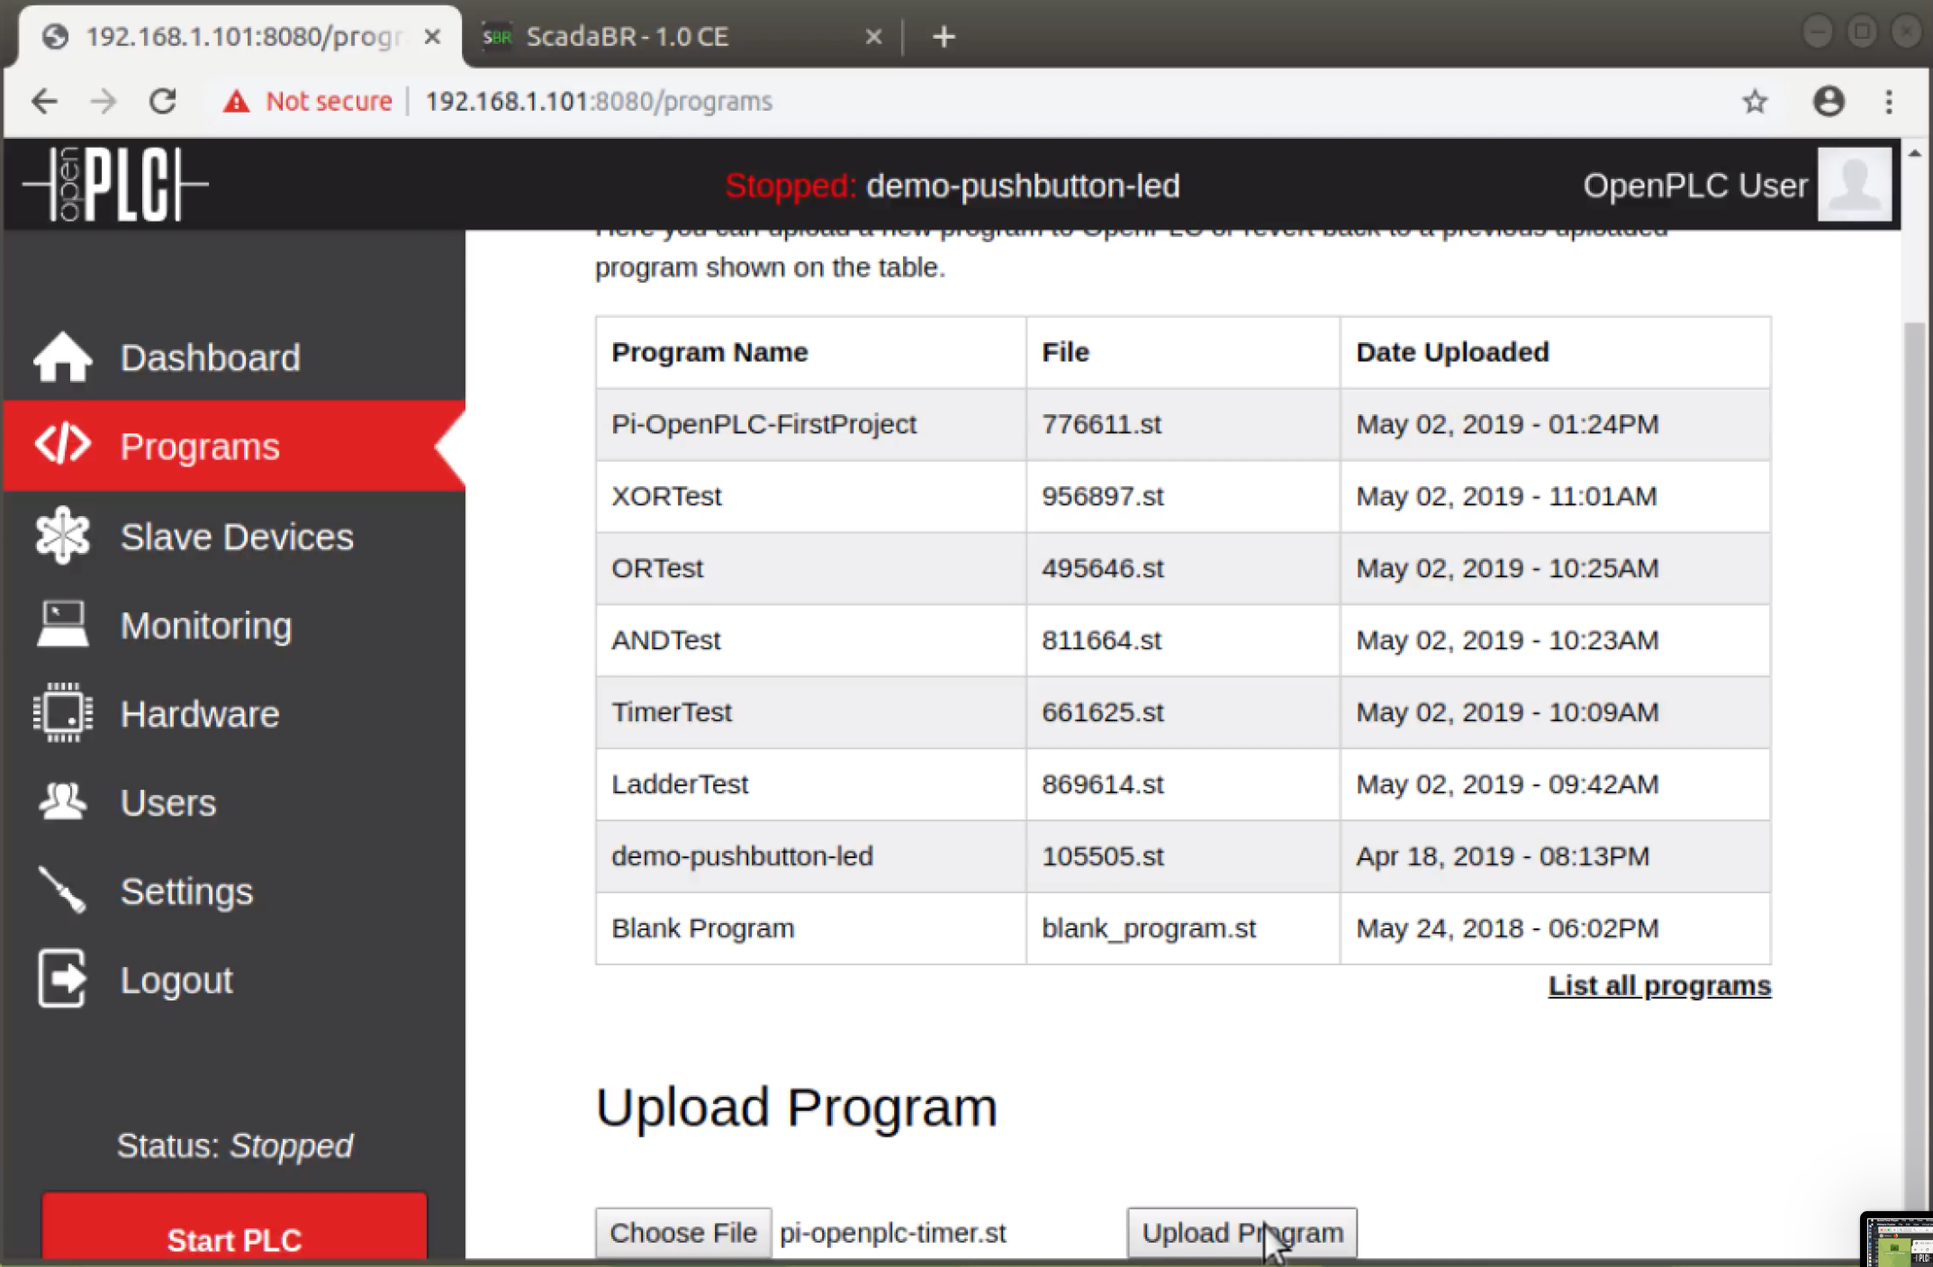
Code Deployment to OpenPLC - 2
Go to Programs tab to select Choose File

Slide 12
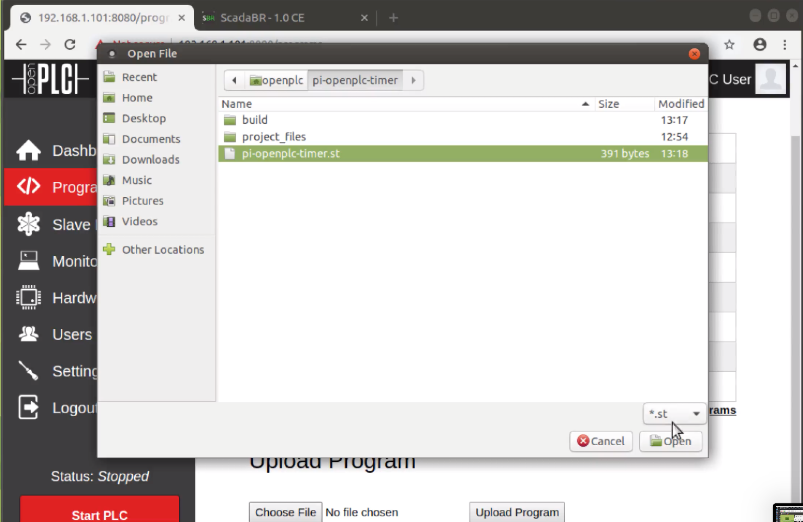
Code Deployment to OpenPLC - 3
Navigate file system and select new program to upload
Hit Upload Program to initiate file transfer to physical OpenPLC

Slide 13
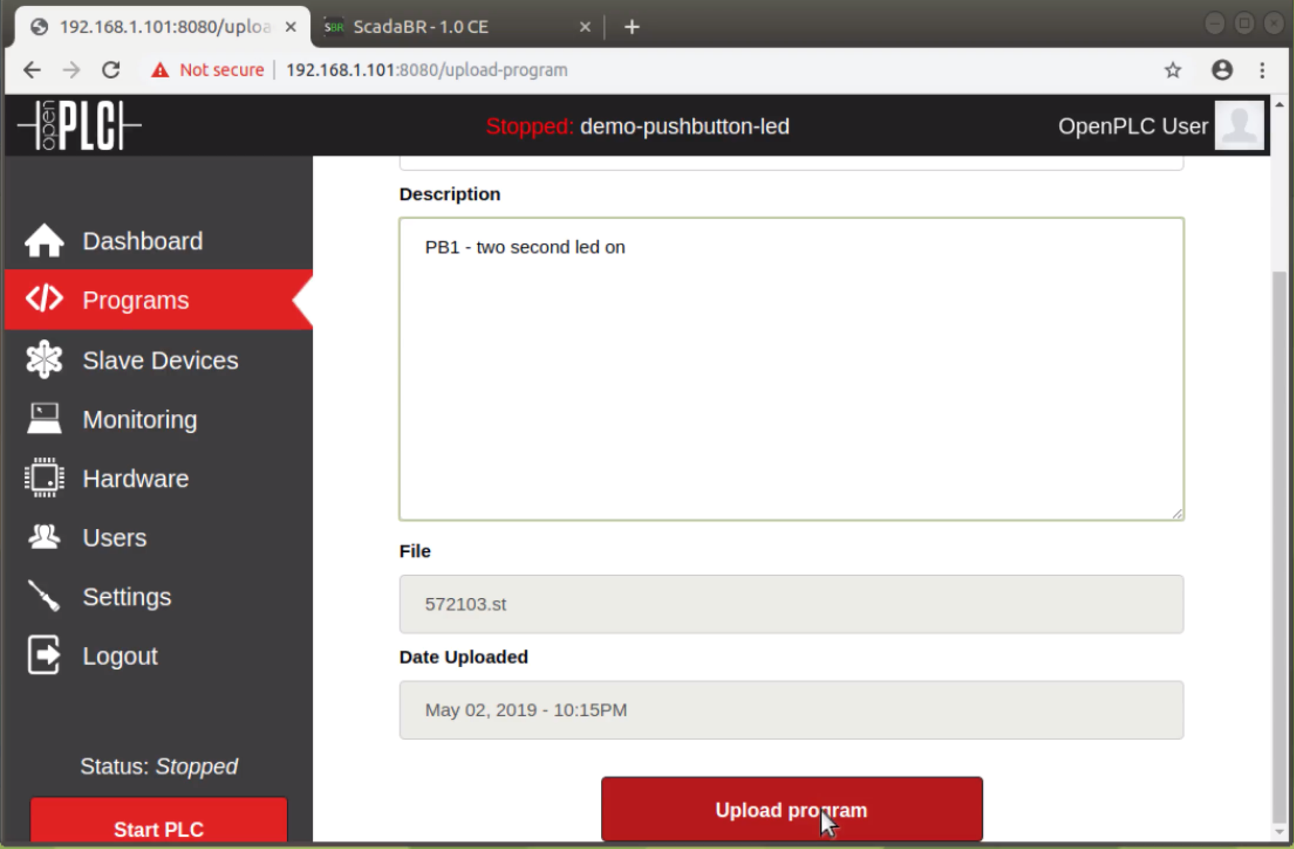
Code Deployment to OpenPLC - 4
Enter project name and description
Scroll down and hit Upload Program to initiate program compilation

Slide 14
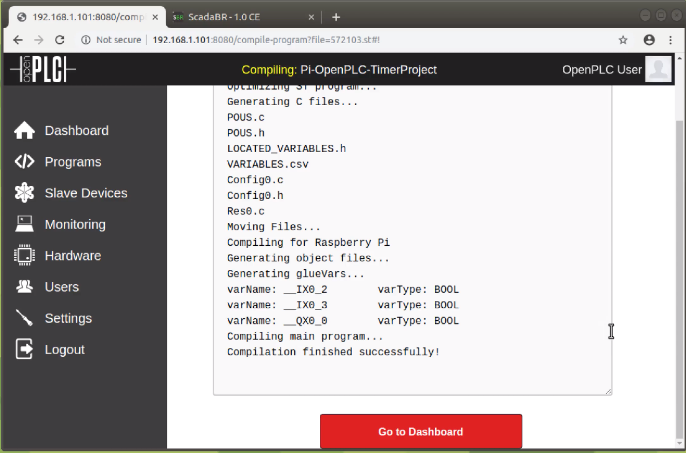
Code Deployment to OpenPLC - 5
Structured text version of program now compiled into C code
C code compiled into a binary executable

Slide 15
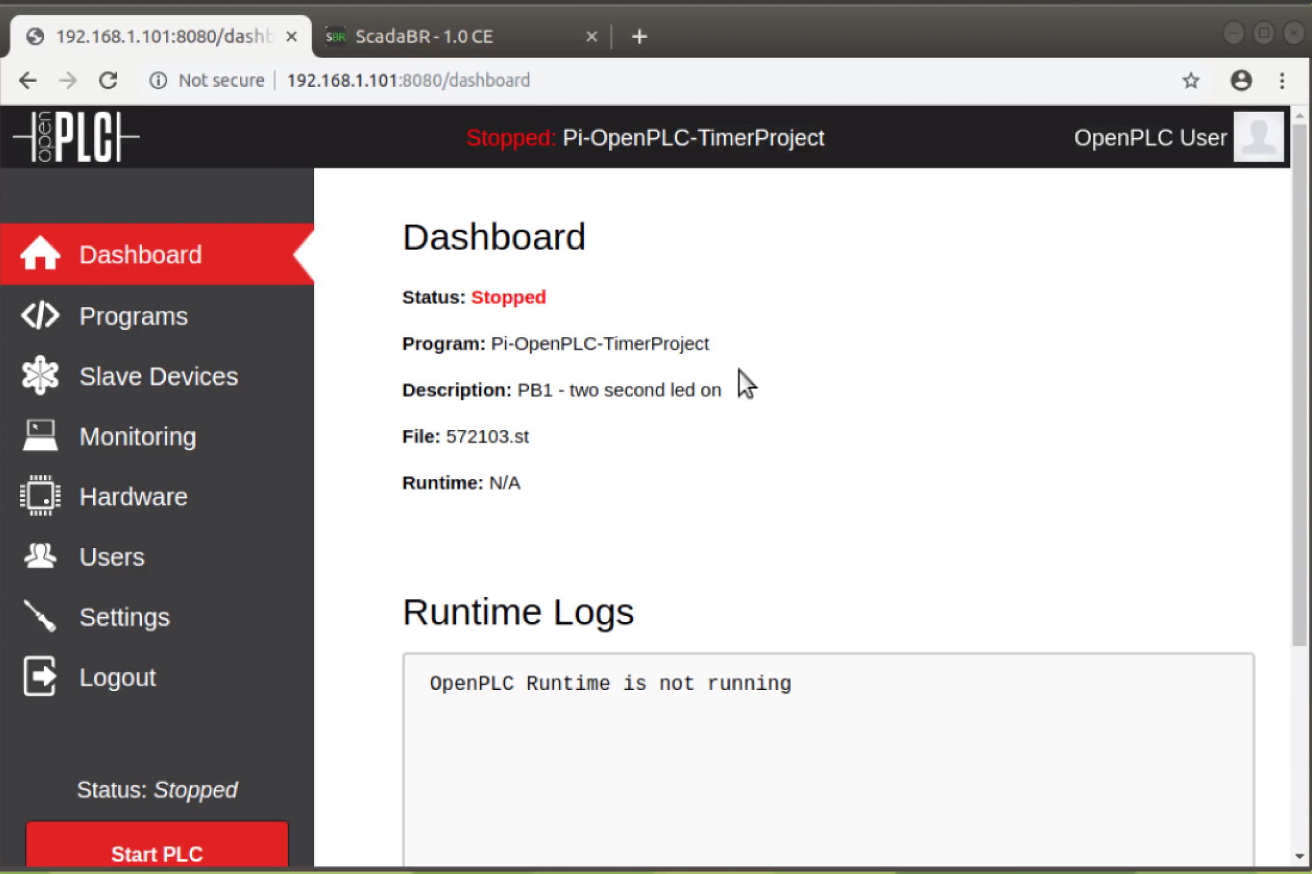
Code Deployment to OpenPLC - 6
Compiled binary program now loaded into physical OpenPLC
Hit Start PLC to execute program

Slide 16
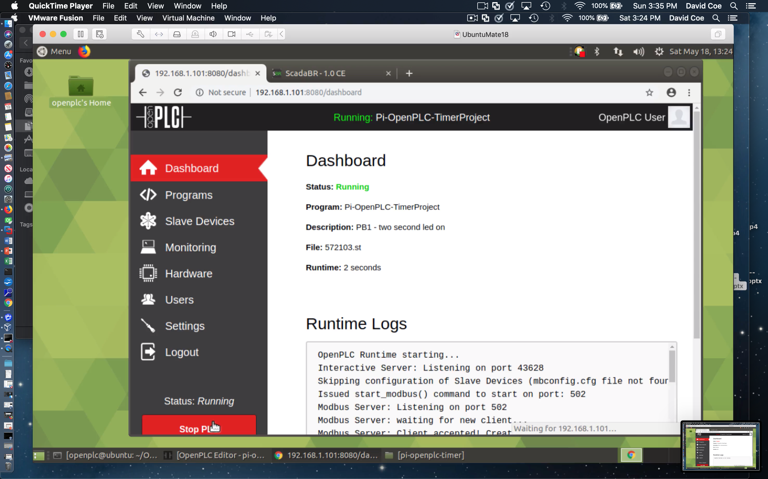
Code Deployment to OpenPLC - 7
Compiled binary program now executing on physical OpenPLC
Hit Stop PLC to terminate program execution

Slide 17
Code Deployment to OpenPLC - 8
Modbus is a legacy serial point-to-point PLC communication protocol
Modbus TCP wraps legacy Modbus packet in TCP wrapper
Port 502 is default port for Modbus TCP communications

Slide 18
Suggested Reading
The OpenPLC Project
https://www.openplcproject.com/
Tommy Morris – Six SCADA Modules
https://clark.center/details/tommy_morris/Six%20SCADA%20Modules

Slide 19
Hands-On Laboratory Exercise #3

Slide 20
Laboratory Exercise #3 Instructions - 1
Objectives
Learn how to use OpenPLC Editor to generate structured text implementation of the First Project Ladder Logic program
Learn how to deploy the generated structured text program to the OpenPLC runtime
Learn how to execute the compiled structured text program on the OpenPLC runtime

Slide 21
Laboratory Exercise #3 Instructions - 2
Use OpenPLC Editor to simulate the First Project Ladder Logic as described at the URL
https://www.openplcproject.com/reference-your-first-project
Use the OpenPLC Editor code generation button to generate the structured text program from your ladder logic program
Configure your OpenPLC runtime instance
Use the browser to access your OpenPLC runtime instance and upload the structured text program
https://www.openplcproject.com/reference-your-first-project

Slide 22
Laboratory Exercise #3 Instructions - 3
Sample Deliverables
Zip file of entire project directory including structured text code
Screenshots of ladder logic and structured text programs
Screenshots of OpenPLC runtime showing successful compilation of structured text program
Screenshots of OpenPLC runtime showing execution of fully compiled program

